Slide 1
Using Seismic Waveforms to distinguish Earthquake from Explosion
Justin Pickett
Eivind Jorstad
Shanece Esdaille

Slide 2
Motivation and Research Question
Why does this matter?
Earthquakes and underground nuclear explosions can produce similar seismic signals.
Correctly identifying the source of seismic events is important for monitoring nuclear testing.
Location, magnitude and depth provide useful information, but may not be sufficient.
Waveform characteristics may reveal additional differences between the two event types.
Our research question
How much do seismic waveforms improve our ability to identify explosions when we can only review a limited number of events? And do more advanced methods provide enough improvement to justify their added complexity?

Slide 3
Data and methodology
Our dataset
38,579 Total seismic events | 22 Dataset columns
32,912 Earthquakes (85.3%) | 5,667 Explosions (14.7%)
Methodology
Compared catalog-only and catalog-plus-waveform features.
Tested depth separately.
Evaluated logistic regression, decision tree and random forest.
Used five-fold geographic cross-validation.
Features used
Catalog information | Waveform information
Location | Crest factor
Magnitiude | Spectral entropy
Time of day | P/S amplitude ratio
Weekend | Rise time
Depth (separate experiment) | Kurtosis and frequency ratios
We analyzed nearly 39,000 events by comparing models using traditional catalog information and additional waveform features. We also used geographic cross-validation to test how well the models generalize to different locations.

Slide 4
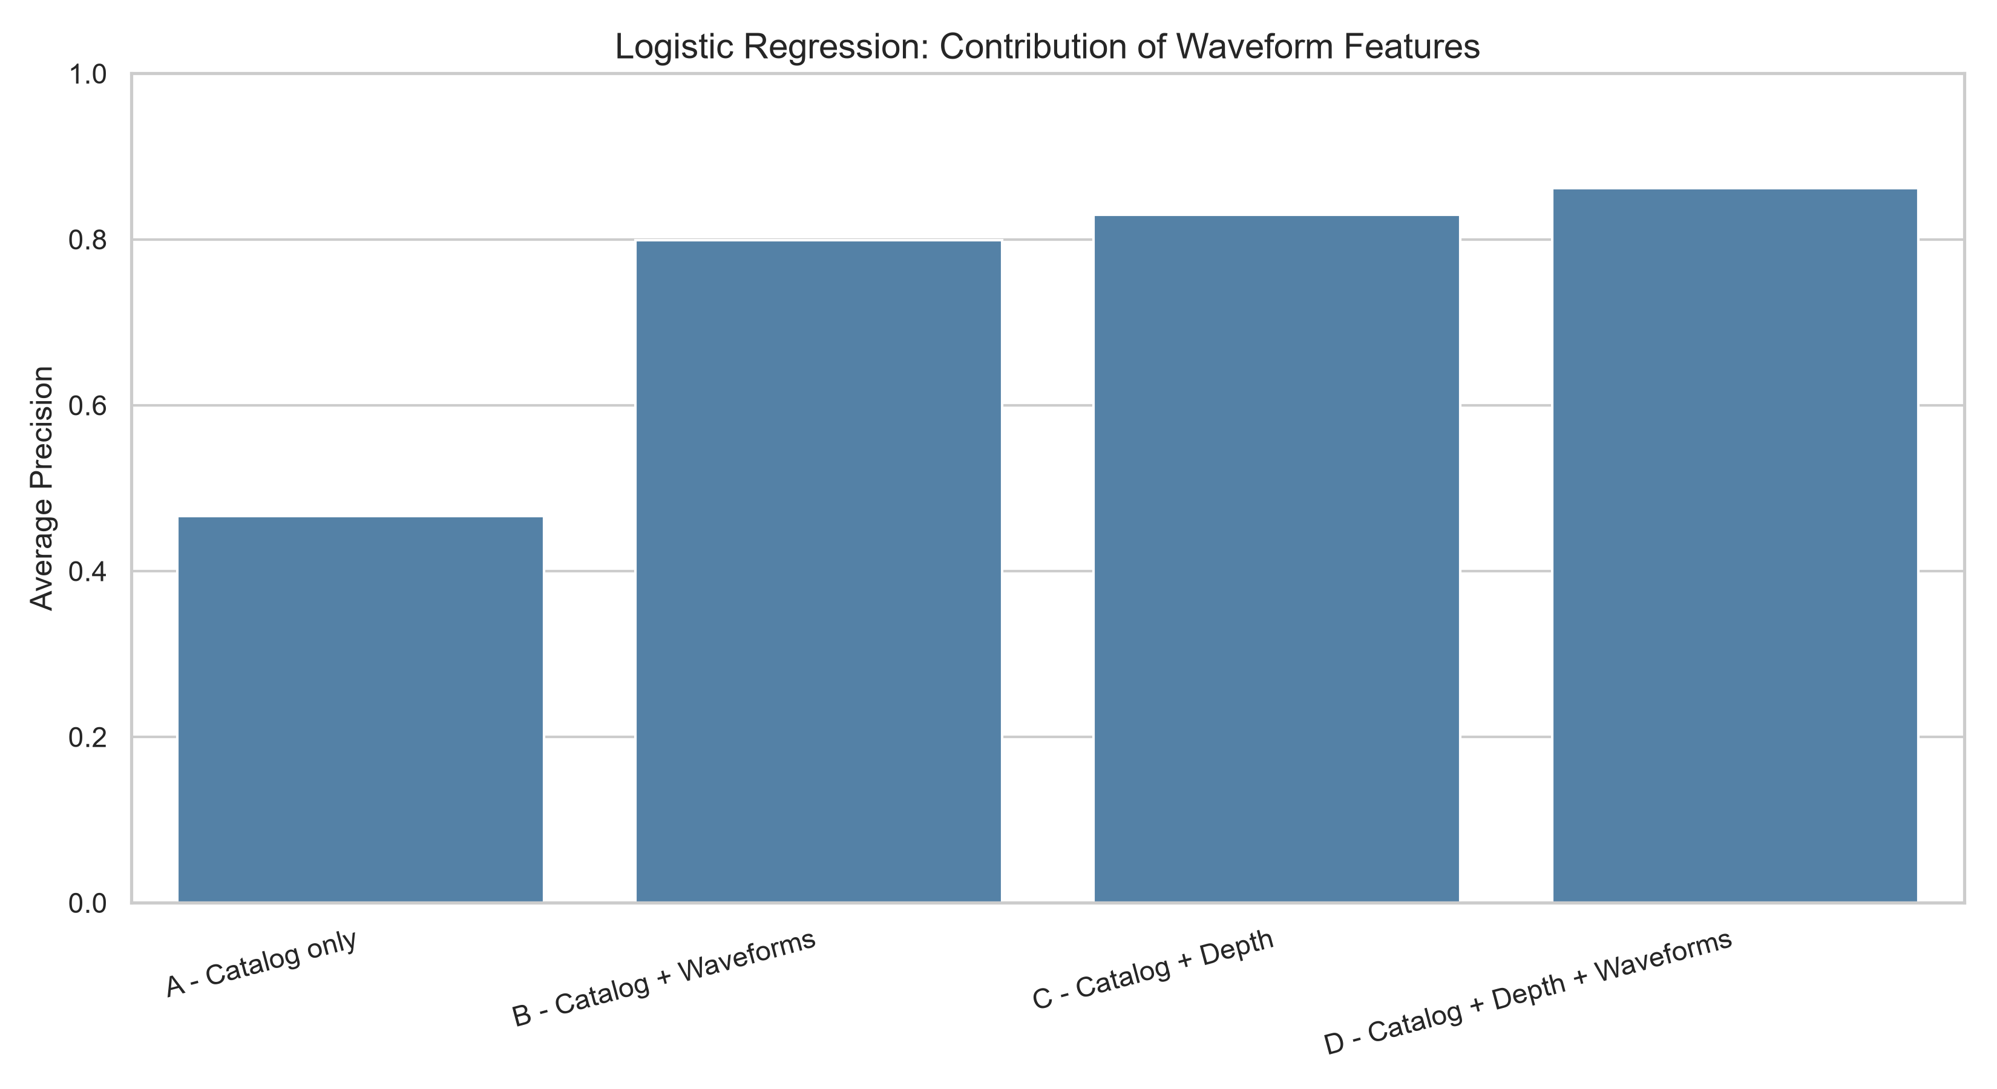
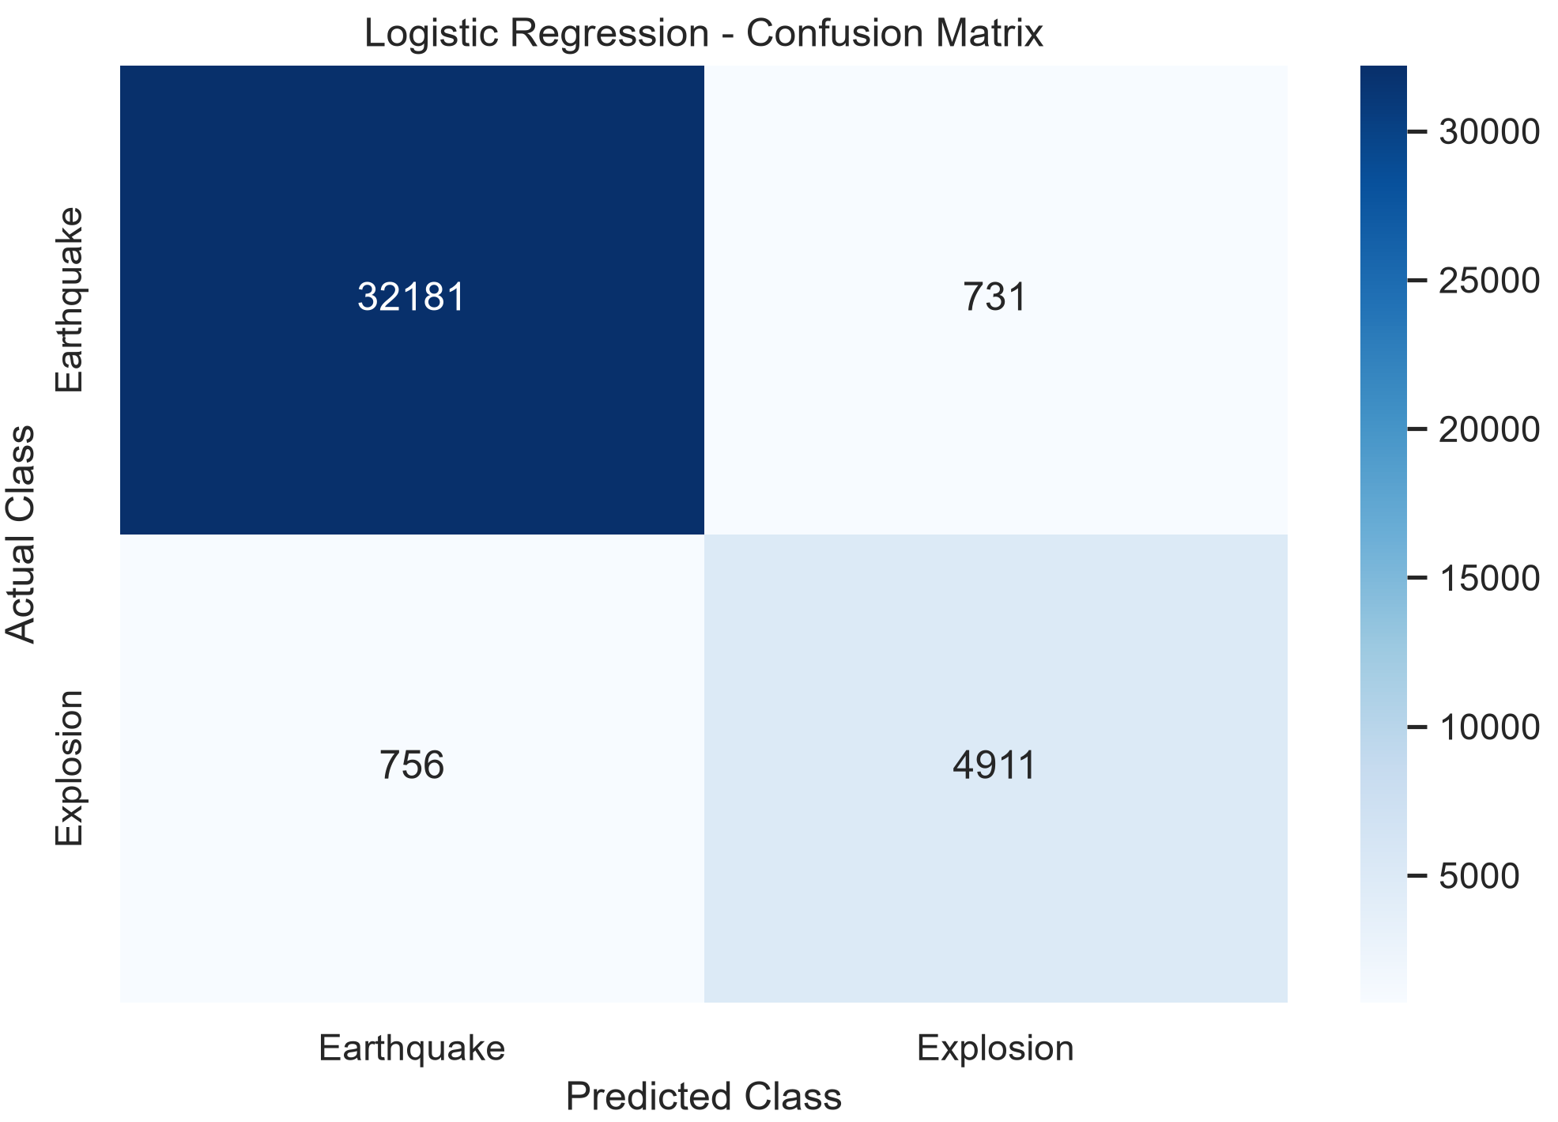
Logistic regression analysis
Key findings
Waveforms increased average precision by 33.30 percentage points without depth (~71.4% relative improvement) .
Adding waveforms to the depth-inclusive model improved average precision by another 3.26 percentage points (~4% relative improvement) .
The best configuration achieved 0.8620 average precision.
Experiment | Average Precision | Mean Fold AP | Fold AP Std | Precision | Recall | F1 Score | ROC AUC
A - Catalog only | 0.4663 | 0.4713 | 0.0481 | 0.5270 | 0.2755 | 0.3618 | 0.8854
B - Catalog + Waveforms | 0.7993 | 0.8063 | 0.0551 | 0.8206 | 0.7233 | 0.7689 | 0.9686
C - Catalog + Depth | 0.8294 | 0.8362 | 0.0385 | 0.8210 | 0.8537 | 0.8370 | 0.9738
D - Catalog + Depth + Waveforms | 0.8620 | 0.8726 | 0.0572 | 0.8704 | 0.8666 | 0.8685 | 0.9833

Slide 5
Decision Tree

Slide 6
Random Forest

Slide 7
Comparing all 3 models
Include table or plot comparing the evaluation metrics of all three models

Slide 8
Conclusion
Final Takeaway
Seismic waveforms contain valuable information for distinguishing explosions from earthquakes, beyond traditional event catalog information????

